Slide 1

CVR COLLEGE OF ENGINEERING Department of CSE B.Tech CSE II Year II Semester Real Time/Field Based Research Project Review-1, Feb. 2025
Student 1 23B81A05K8 – K.ANKITHA
Student 2 23B81A05L7 – L. HARSHITH
Student 3 23B81A05P1 – P. SAIDEEPAK

Slide 2

ExploreEase: Smart Tourism Management System
Project Title: ExploreEase: Smart Tourism Management System.
Students: K.Ankitha, L.Harshith, P. Sai Deepak.
Roll Numbers: 23B81A05K8,23B81A05L7, 23B81A05P1
Institution: CVR College of Engineering
Department: CSE, B.Tech II Year II Semester
Research Review: Real-Time/Field-Based Research Project Review-I, Feb 2025

Slide 3
Introduction
Problem Domain
Current tourism platforms do not offer seamless state-wise road trip packages with custom vehicle selection, accommodation, and food.
Problem Definition
Develop a tourism website that provides customized road-trip-friendly packages across
Telangana, Andhra Pradesh, Karnataka, Maharashtra, and Goa.
Includes private vehicles, buses, accommodations, and food options.
.

Slide 4
Existing Work & Challenges
Existing Solutions
MakeMyTrip, Yatra, Thomas Cook – Offer full-fledged travel booking (flights, hotels, packages).
Thrillophilia, TravelTriangle – Focus on adventure & customizable packages.
SOTC – Provides guided tours & group travel options.
Challenges
Limited Customization – Most platforms lack dynamic customization options (vehicles, accommodation, add-ons).
Complex Booking Process – Multiple steps and external redirections cause confusion.
High Costs & Hidden Charges – Extra charges for modifications, cancellations, and peak season
Overcoming the Disadvantages
Flexible & Customizable Packages – Users can personalize vehicles, accommodation, and food.
Seamless Booking Flow – Simple UI with direct selections, reducing confusion.
Transparent Pricing – No hidden charges, clear cost breakdown for every selection.

Slide 5
Literature Review
1. Goibibo
Dynamic Pricing: Offers deals based on demand and availability.
Multi-Transport Booking: Allows booking flights, trains, and buses along with hotels.
GoCash Rewards: Provides loyalty points for discounts on future bookings.
2. MakeMyTrip
Comprehensive Travel Solutions: Covers flights, hotels, and holiday packages.
Customizable Itineraries: Users can modify travel plans before booking.
24/7 Customer Support: Ensures assistance throughout the trip.
3. SOTC
Key Features Relevant to ExploreEase:
International & Domestic Packages: Offers curated tours for different budgets.
Group Travel Options: Specializes in family and corporate packages.
Visa Assistance: Helps travelers with documentation and visa applications.

Slide 6
Proposed Method & Modules
Proposed Method
Tourism Website with Custom Road-Trip Packages
Modules
1️⃣ User Authentication (Login/Signup) 2️⃣ Package Selection (State-wise & Category-wise Packages) 3️⃣ Vehicle Selection (4-12 seater cars/buses) 4️⃣ Optional Accommodation Selection 5️⃣ Optional Food Selection 6️⃣ Booking & Payment System 7️⃣ Driver & Trip Review System

Slide 7
Functional & Non-Functional Requirements
Functional Requirements
✅ User Authentication ✅ Dynamic Package Selection ✅ Vehicle & Seat Selection ✅ Accommodation & Food Integration ✅ Payment Processing ✅ Trip Review System
Non-Functional Requirements
🔹Secure & Scalable Database 🔹 High Performance & Reliability 🔹 User-Friendly Interface

Slide 8
Hardware & Software Requirements
Hardware Requirements
Server: At least 8GB RAM, 4-core CPU
Cloud Storage: AWS RDS / Firebase
Software Requirements
Frontend: HTML, CSS, JavaScript
Backend: Node.js, Express.js
Database: MySQL
API Integrations: Google Maps API, Razer Pay

Slide 9
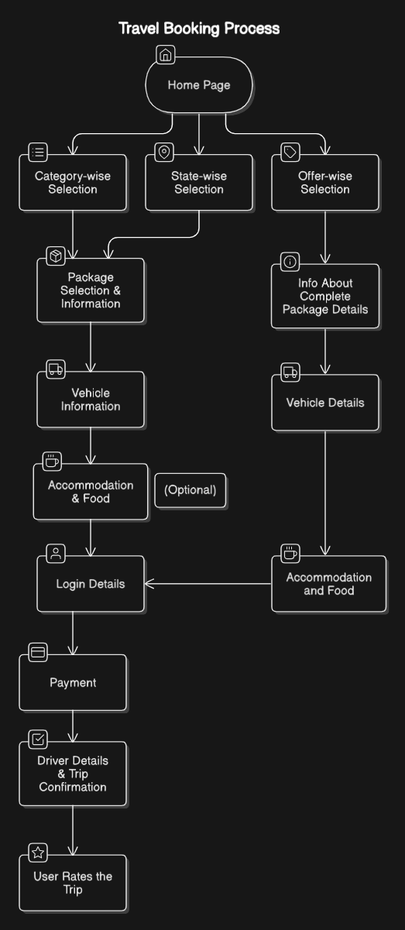

FLOW CHART :

Slide 10
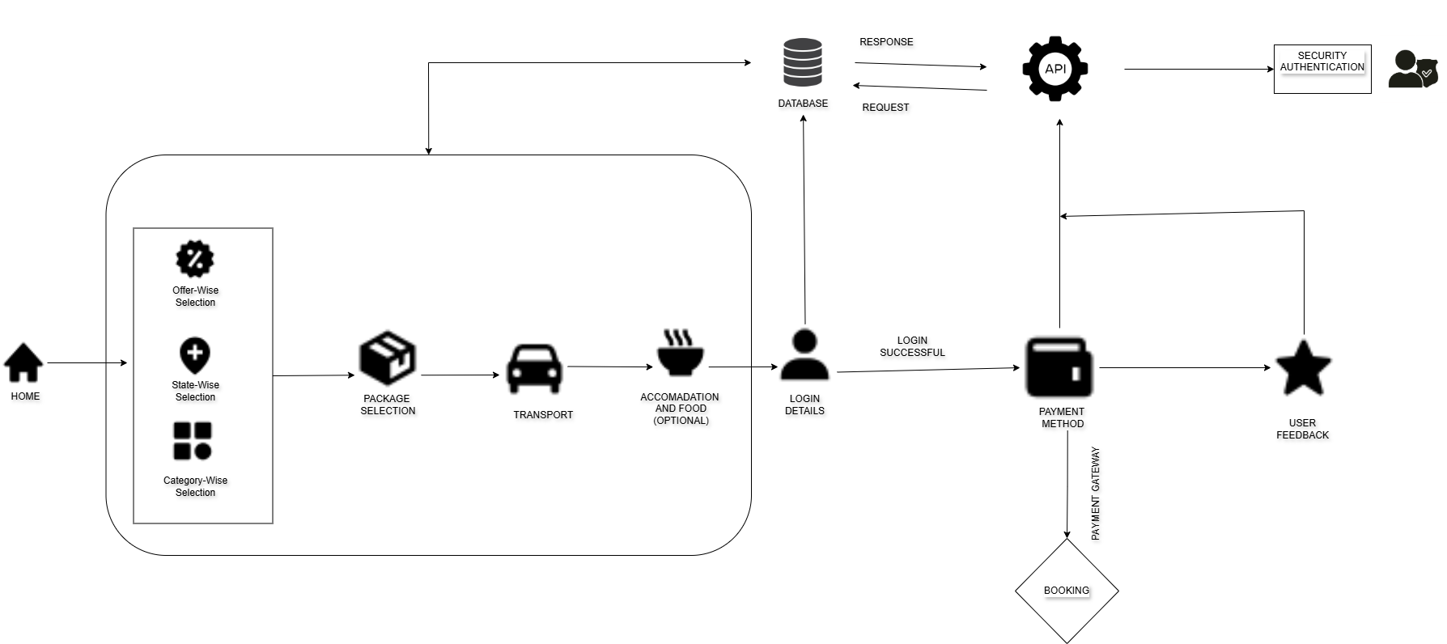
Architecture Diagram

Slide 11
References
🌍 Web References:
MakeMyTrip (www.makemytrip.com) – Full travel booking (flights, hotels, packages).
Yatra (www.yatra.com) – Online travel packages & hotel bookings.
Thrillophilia (www.thrillophilia.com) – Adventure trips & curated experiences.
SOTC (www.sotc.in) – Guided tours & international travel.

Slide 12
THANK YOU…

